Slide 1

Railway Management System
R.Harish Ganesh-18112020
B.Jawahar-18112022

Slide 2
DataBase Management Systems
Using a normal file system can cause various problems like data redundancy and in data isolation, integrity problems and security problems. This can be overcomed by using DataBase Management Systems.
In this, the data schema is given in Data Definition Language (DDL) and Data is manipulated using Data Manipulation Language (DML). SQl is the widely developed language for developing a DataBase Management System.

Slide 3
Railway Management System
This database is created in such a way that the user can see the details of the train, available seats in the train, and the employees can see passenger details, details of the booked ticket and it can also delete the tickets which are cancelled.
Passengers can book the tickets based on the availability of tickets in general and AC classes. This contains a detailed record of the trains which includes the train number and name, its starting place and destination, and the days in which the train is available and the seat availability.
Passengers can see the details of the ticket booked using their PNR number which is a unique primary key and using this the ticket can also be cancelled.

Slide 4
Railway Management System
In this model, the total no. of trains used is 5 and in-between stations are not considered. There are 2 types of seats: General and AC. There are 5 entities in this model:
Train
TrainStatus
Passenger
BookedTicket
Cancel

Slide 5
Entities and their attributes:
Train:
Train_Number, Train_Name, Source, Destination, AC_cost,Gen_cost, mon_aval, Tue_aval, Wed_aval, Thu_aval, Fri_aval, Sat_aval, Sun_aval.
TrainStatus:
TrainDate, Ac_Seat, Gen_seat, TrainNumber
Passenger:
PNR_no, PName, PAddress, PAage, PSeat_type, PStatus, PGender, BookedDate, TrainNumber
BookedTicket:
train_Number, BookedDate, Seat_type, PNR_no
Cancel:
PNR_no, BookedDate

Slide 6
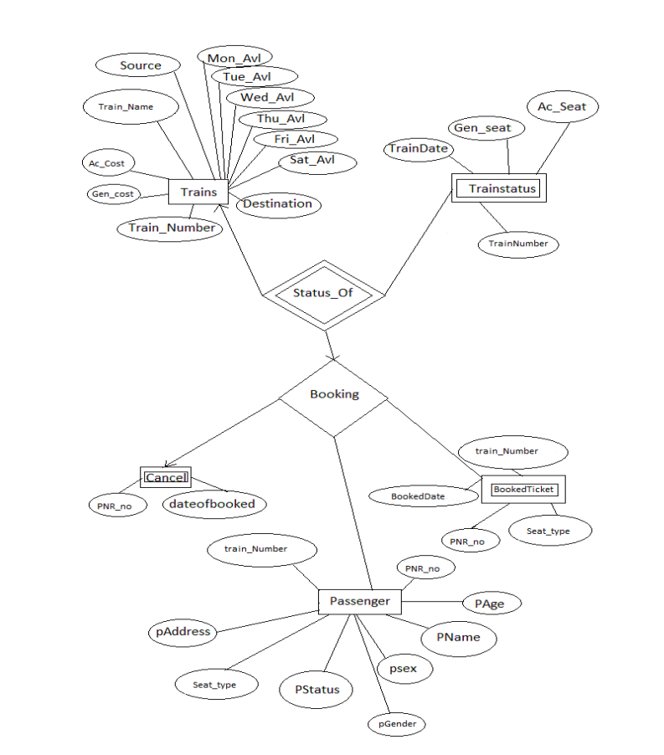

Slide 7
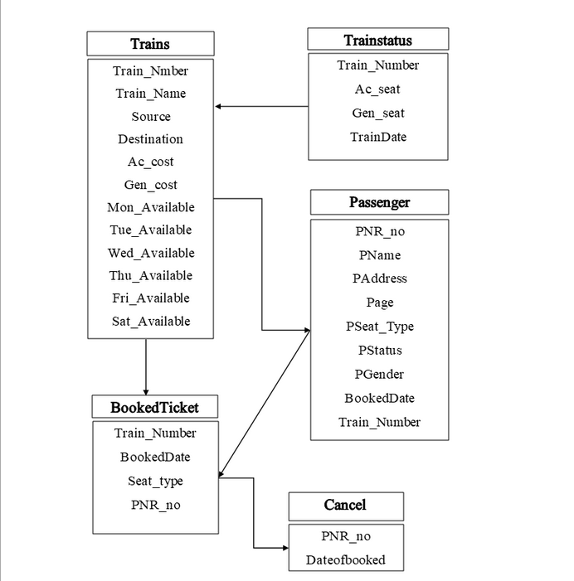

Slide 8
Creating Table Train:
Create Table Train
( Train_Number int NOT NULL, Train_Name varchar(20), Source varchar(20), Destination Varchar(20), Ac_Cost varchar(20), Gen_Cost varchar(20), Mon_Available Varchar(20), Tue_Available Varchar(20), Wed_Available Varchar(20), Thu_Available Varchar(20), Fri_Available Varchar(20), Sat_Available Varchar(20), Sun_Available Varchar(20), PRIMARY KEY (Train_Number) );

Slide 9
Creating Table TrainStatus
Create Table TrainStatus ( TrainDate Date, Ac_Seat Number(20), Gen_Seat Number(20), TrainNumber number(20), FOREIGN KEY (TrainNumber) REFERENCES Train(Train_Number) );

Slide 10
Creating Table Passenger
Create Table Passenger ( PNR_no number(5), PName varchar(20), PAddress varchar(20), PAge number(20), PSeat_type varchar(20), PStatus varchar(20), PGender varchar(20), BookedDate date(20), TrainNumber number(20), PRIMARY KEY (PNR_no) , FOREIGN KEY (TrainNumber) REFERENCES Train(Train_Number) );

Slide 11
Creating Table BookedTicket
Create Table BookedTicket ( train_Number Number Not Null, BookedDate date, Seat_type varchar(10), PNR_no Number, FOREIGN KEY (Train_Number) REFERENCES Train(Train_Number) );

Slide 12
Creating Table Cancel
Create Table Cancel ( PNR_no Number(10), Dateofbooked date, FOREIGN KEY (PNR_no) REFERENCES Passenger(PNR_no) );

Slide 13
Inserting Values:
insert into Train VALUES(12839,'Howrah Mail','MGR Chennai Central','Howrah',2100,700,'Yes','Yes','Yes','Yes','Yes','Yes','Yes');
insert into Train VALUES(12621,'TamilNadu Express','MGR Chennai Central','New Delhi',2600,850,'Yes','Yes','Yes','Yes','Yes','Yes','Yes');
insert into Train VALUES(01022,'Ganpati Express','Yesvanthpur Central','Dadar Central',2000,500,'No','Yes','No','No','Yes','Yes','No');
insert into Train VALUES(20801,'Magath Express','Islampur','New Delhi',1050,300,'Yes','Yes','Yes','Yes','Yes','Yes','Yes');
insert into Train VALUES(12509,'Guwahati Express','Bangalore','Guwahati',3450,900,'No','No','Yes','Yes','Yes','No','No');
INSERT into Train VALUES (12663,'Tiruchirapalli SF Express','Howrah','Tiruchirapalli',3000,800,'No','No','No','Yes','No','No','Yes');

Slide 14
Inserting Values:
INSERT INTO TrainStatus VALUES('09/04/2021',12,4,20801);
INSERT INTO TrainStatus VALUES('09/04/2021',16,20,12839);
INSERT INTO TrainStatus VALUES('10/04/2021',9,15,12621);
INSERT INTO TrainStatus VALUES('08/04/2021',18,3,12663);
INSERT INTO TrainStatus VALUES('08/04/2021',22,14,12509);

Slide 15
Inserting Values:
INSERT INTO Passenger VALUES(1,'Dayaram','some',42,'General','Booked','Male','08/04/2021',12663);
INSERT INTO Passenger VALUES(2,'Sana','other',33,'General','Booked','Female','10/04/2021',12621);
INSERT INTO Passenger VALUES(3,'Ajay','Random',20,'AC','Booked','Male','09/04/2021',20801);
INSERT into BookedTicket VALUES(12663,'08/04/2021','General',1);
INSERT into BookedTicket VALUES(12621,'10/04/2021','General',2);
INSERT into BookedTicket VALUES(20801,'09/04/2021','AC',3);
insert into Cancel VALUES(1,'08/04/2021')

Slide 16
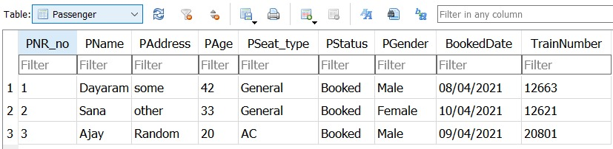

Slide 17
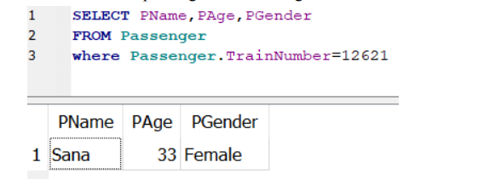
SQL Queries:
1. Details of passenger travelling in TamilNadu Express (12621):

Slide 18
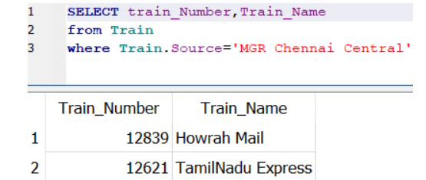
SQL Queries:
Trains starting from MGR Chennai Central:

Slide 19
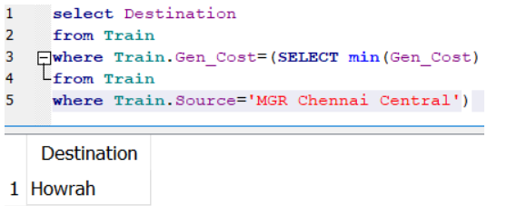
SQL Queries:
Destination that can be arrived with minimum cost:

Slide 20
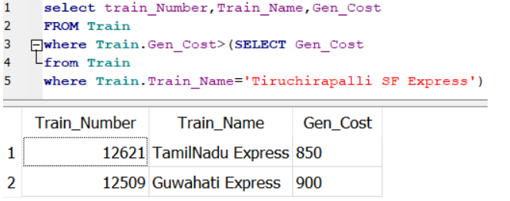
SQL Queries:
Trains that cost less than Tiruchirapalli SF Express:

Slide 21
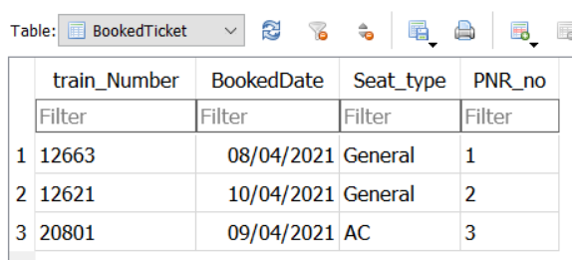
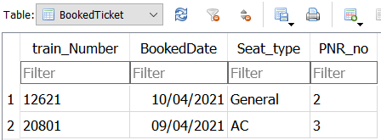
SQL Queries: Cancelling Booked Ticket
Before cancelling
Query:
After cancelling:

Slide 22
Conclusion:
We created a database that can be used for keeping track of train booking. The booking process is divided into 5 entities. Train, TrainStatus, Passenger, BookedTicket, Cancel which reduced the complexity of the booking process. Also enabling the user to access the necessary information without making any changes to other data which are to be protected.

